Slide 1

FARMIFY
FARMIFY.COM
By Adi, Simeon, Tommy

Slide 2
AGENDA
FARMIFY
FARMIFY.COM
WHO WE ARE
CUSTOMERS
OUR PRODUCTS
CONTACT US
Farmify offers a wide range of fresh, locally sourced products, including fresh meat, seasonal fruits, dairy, locally-grown teas, bakery goods, and raw honey. Our focus is on providing high-quality products that meet the diverse needs of our consumers while supporting local producers.
We provide a platform that uses an app that uses Dutch Auction to help local farmers sell their fresh groceries!
Join Us If you would love to have fresh groceries delivered to your door from local farmers!
tommyxu@bu.edu
gluzmans@bu.edu
abhan03@bu.edu

Slide 3
Farmify: Connecting Local Farmers to Consumers
FARMIFY
FARMIFY.COM
FRESHNESS
FAST DELIVERY
EASY TRANSACTION
Shorten the supply chain.
Create direct connections between farmers and consumers.Dutch auction model to ensure fair pricing for all.

Slide 4
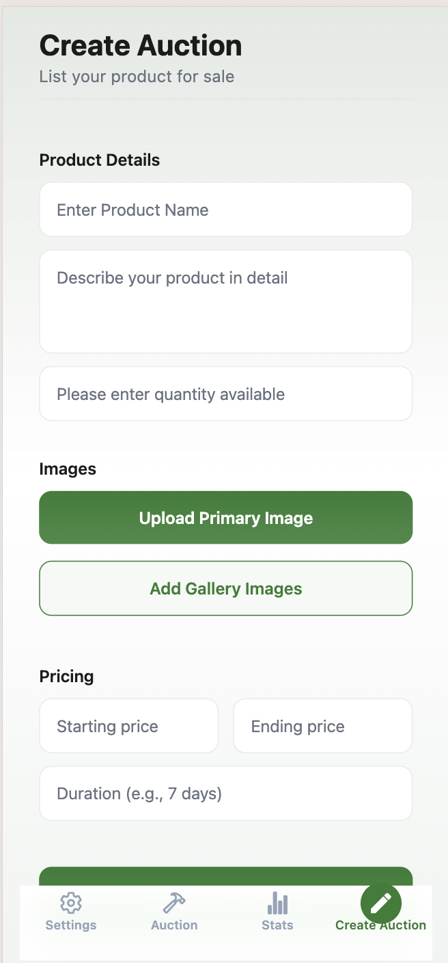
How Does Farmify Work?
The Dutch Auction Model
1. Price Begins High: The starting price sets at a higher level to reflect the best possible value for the produce.
2. Price Gradually Decreases: Over time, the price begins to drop at regular intervals. This continues until a buyer finds the price satisfactory and decides to make a bid.

Slide 5
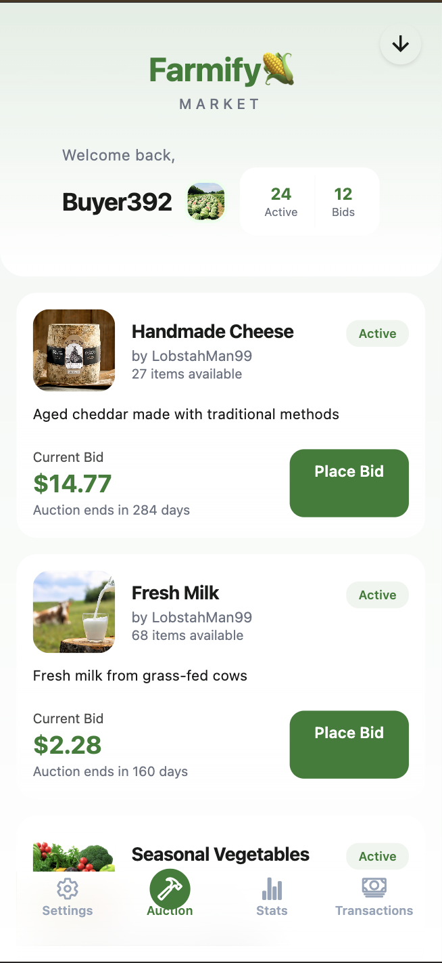
Features
Buyers
Sellers
Browse Auctions
Purchase products
Pickup/Delivery
Paypal Integration
Doordash Integration
View past orders
Rate Seller
View sitewide statistics
Update Profile Picture
Update user information
Create new listings
Browse auctions
Upload photos
Paypal Business account integration
Doordash seller account
View sitewide statistics
Update Profile Picture
Update Seller Information
Notes:
Simeon

Slide 6




Technologies used
C# ASP.net backend
React Native + Expo frontend
Supabase PostgresSQL DB
Supabase Storage bucket
Paypal sandbox developer platform
Doordash developer platform
Google OAuth 2.0
Docker
Notes:
Simeon

Slide 7
Demo Assumptions:
FARMIFY
FARMIFY.COM
The Seller is a Local new england Fisherman who got lucky with some lobster traps.
They Buyer is a student at BU who missed the lobster night while studying for his CS392 Midterm. It’s getting late and missing out would be unacceptable!
Seller and Buyer Already Registered on our website
Seller and Buyer Already Registered on paypal (and seller shared their account ID and secret key)
Seller & Buyer on separate tabs (to simulate different devices)

Slide 8
DEMO

Slide 9
Future Work
Bad-Seller Detection
Buyer Ratings
Written Reviews
Rating Delay
Non-Linear Price Decrease
Seller Safety Verification
Searching, Category
Chat with Seller
Category Selection
Notes:
Simeon

Slide 10
Reflection

Slide 11
THANK YOU!

